Slide 1

Game Review Analysis
Performed by: Ian Pope & August Cross

Slide 2
Contributions for the Project
Ian
August
Role: Dedicated Program Engineer
Testing Algorithm Selection
Writing and Executing Code
Visualization Compilation
Project Report Writing - Method and Results
Note Taking - Algorithm Response and Interaction
Role: Post-Execution Compiler
Test Algorithm Research
Research Problem Statement
Research Impact Reflection
Project Report Writing - Formalities and Relative Works
Note Taking - Project Process and Relative Steps

Slide 3
Problem Statement & Proposed Solution
Problem Statement
Proposed Solution
Lack of consumer consideration is being taken in video game development, resulting in increased negative response to newer titles.
Provide a method for game development teams to predict the success of their game and make adjustments to maximize success on new titles.

Slide 4
What were our Motivations?
Real-World Use Case
Intriguing Subject
Using real data table to ensure realistic results.
Video games are a mutually intriguing subject.
Algorithm Testable
Game-Dev Integration
A scenario that can test why algorithm selection occurs.
Further research into this area could be beneficial.

Slide 5
Project Objectives
01
02
03
04
Dataset
Compare
Find realistic, useable dataset to test with
Compare accuracies between outcomes
Test Algorithms
Find Ideal Algorithm
Execute testing of listed algorithms
Determine which algorithm(s) executed the best

Slide 6
Related Works of Algorithms
Naive Bayes
SVM
Decision Tree
Multitude of classification algorithms
Maximum distance based algorithm using hyperplanes
Tree-like node-based classification algorithm
Logistic Regression
Linear Regression
K-Nearest Neighbor
Binary identification algorithm using sigmoid function
Reliable classification algorithm with variable output
Distance-based node identification algorithm

Slide 7
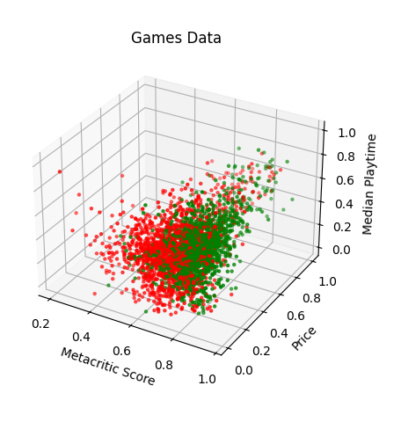
Makeup of Used Data
X
Z
Y
Game Price
Metacritic
The listed pricing of the game on the Steam store
The listed score of the game on Metacritic
Median Gametime
Median amount of aggregate time spent in the game

Slide 8
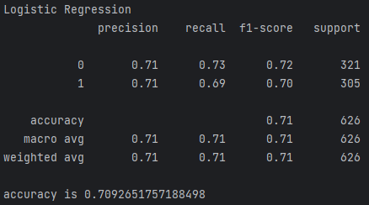
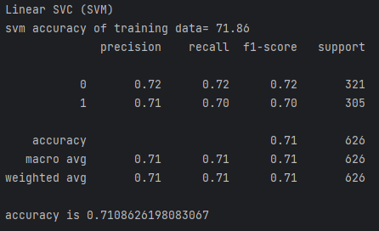
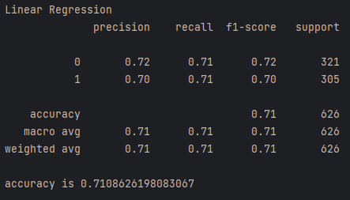
Algorithm Results
70.9%
71.1%
71.1%
Logistic Regression
Linear SVC (SVM)
Linear Regression

Slide 9
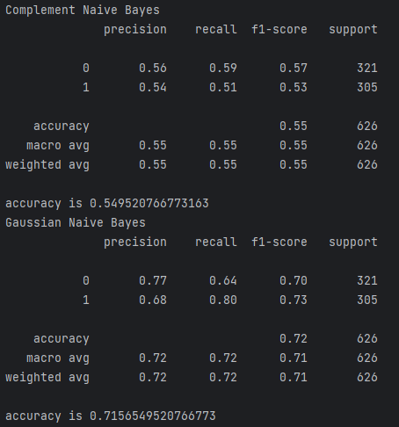
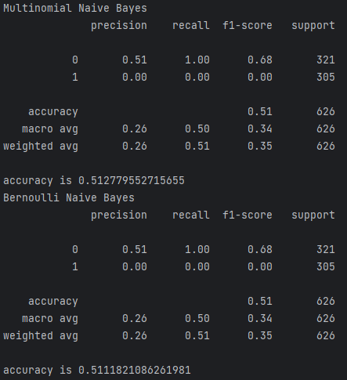
Algorithm Results- Naive Bayes
*Four Naive Bayes models were ran, with highest chosen for later comparison

Slide 10
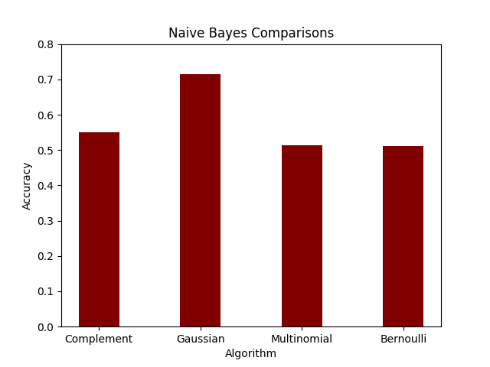
Algorithm Results- Naive Bayes
Complement
Gaussian
55.0%
71.6%
Multinomial
Bernoulli
51.3%
51.1%

Slide 11
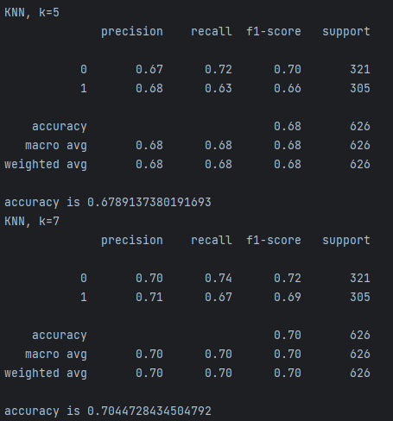
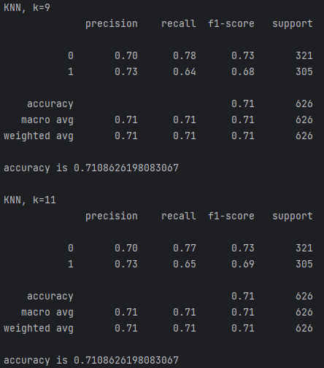
Algorithm Results- KNN
*Four KNN models were ran, with highest chosen for later comparison

Slide 12
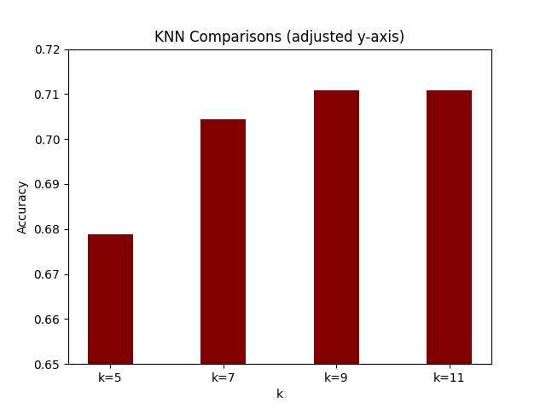
Algorithm Results- KNN
K = 5
K = 7
67.9%
70.4%
K = 9
K = 11
71.1%
71.1%

Slide 13
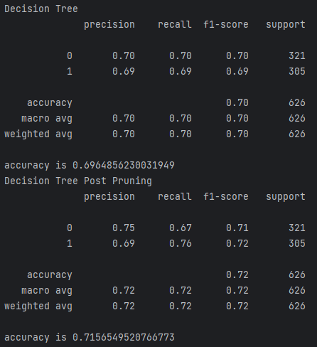
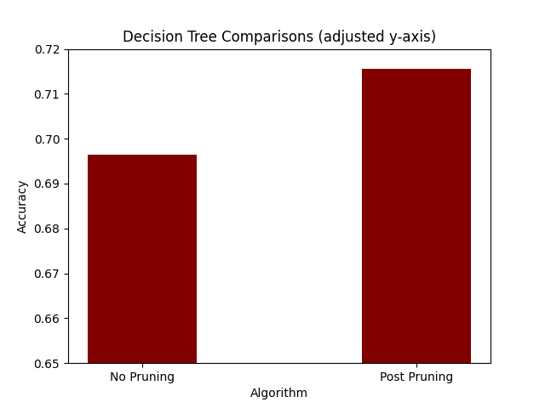
Algorithm Results- Decision Tree
*Two decision tree models were ran, no pruning and post pruning
71.6%

Slide 14
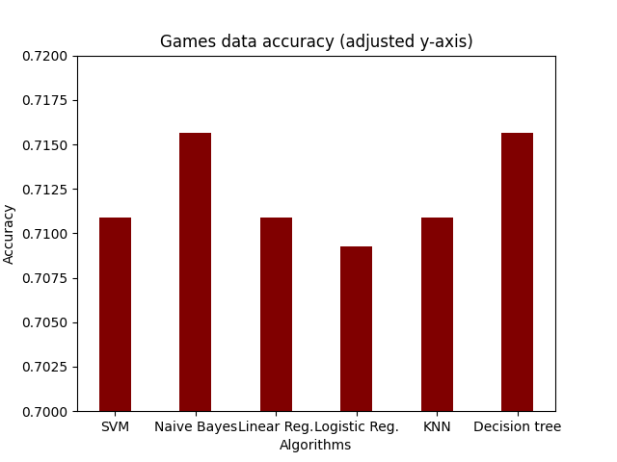
What are the best algorithms?
Decision Tree
The post-pruned tree tied for the highest accuracy
Gaussian Naive Bayes
The Gaussian model of Naive Bayes also tied for highest accuracy

Slide 15

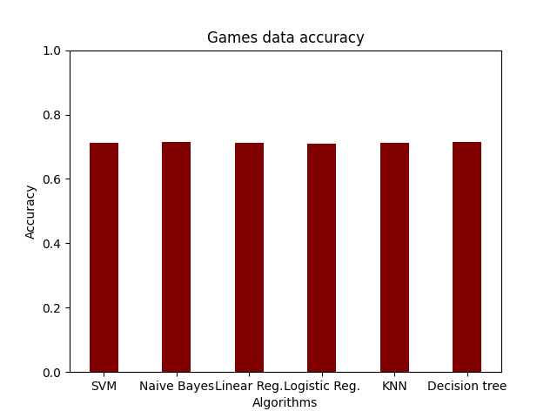
Not So Fast
The actual variation between the best of each model was only 0.0064 or less than 1%
The post-pruned decision tree and Gaussian Naive Bayes algorithms had the highest variances in precision and recall between classes.
Is there a best classifier for this problem?
What information has this experiment given?

Slide 16
Resources
C. Martins, “Gaussian naive Bayes explained with Scikit-Learn,” Built In, https://builtin.com/artificial-intelligence/gaussian-naive-bayes (accessed Apr. 20, 2024).
A. V. Ratz, “Multinomial NAЇVE Bayes’ for documents classification and Natural Language Processing (NLP),” Medium, https://towardsdatascience.com/multinomial-na%C3%AFve-bayes-for-documents-classification-and-natural-language-processing-nlp-e08cc848ce6 (accessed Apr. 20, 2024).
GeeksforGeeks, “Complement naive Bayes (CNB) algorithm,” GeeksforGeeks, https://www.geeksforgeeks.org/complement-naive-bayes-cnb-algorithm/ (accessed Apr. 20, 2024).
N. Sharma, “Bernoulli naive Bayes and it’s implementation,” Medium, https://medium.com/@nansha3120/bernoulli-naive-bayes-and-its-implementation-cca33ccb8d2e (accessed Apr. 20, 2024).
V. Kanade, “All you need to know about support vector machines,” Spiceworks Inc, https://www.spiceworks.com/tech/big-data/articles/what-is-support-vector-machine/#:~:text=A%20support%20vector%20machine%20(SVM)%20is%20a%20machine%20learning%20algorithm,classes%2C%20labels%2C%20or%20outputs (accessed Apr. 20, 2024).
V. Kanade, “Logistic regression: Equation, assumptions, types, and best practices,” Spiceworks Inc, https://www.spiceworks.com/tech/artificial-intelligence/articles/what-is-logistic-regression/#:~:text=Practices%20for%202022-,What%20Is%20Logistic%20Regression%3F,1%2C%20or%20true%2Ffalse (accessed Apr. 21, 2024).
V. Kanade, “What is linear regression?- Spiceworks - Spiceworks,” Spiceworks Inc, https://www.spiceworks.com/tech/artificial-intelligence/articles/what-is-linear-regression/ (accessed Apr. 21, 2024).
“What is the K-nearest neighbors algorithm?,” IBM, https://www.ibm.com/topics/knn#:~:text=The%20k%2Dnearest%20neighbors%20(KNN)%20algorithm%20is%20a%20non,of%20an%20individual%20data%20point (accessed Apr. 21, 2024).
N. Chauhan, “Decision tree algorithm, explained,” KDnuggets, https://www.kdnuggets.com/2020/01/decision-tree-algorithm-explained.html (accessed Apr. 21, 2024).
O. Pramod, “Decision trees,” Medium, https://medium.com/@ompramod9921/decision-trees-8e2391f93fa7#:~:text=max_depth%3A%20This%20parameter%20controls%20the,a%20maximum%20value%20for%20max_depth. (accessed Apr. 21, 2024).
M. Baas, “Heuristics for assessing steam game reviews [part 1],” M Baas, https://rf5.github.io/2020/12/13/steam-reviews.html#:~:text=A%20%25%20positive%20review%20score%20of,top%2020%25%20of%20games). (accessed Apr. 21, 2024).

